Slide 1
Smart Grid Final Project
PROJECT OPTION: SELF-PROPOSED NETWORK
Presented by: Haocong Wang
Dazhi Li

Slide 2
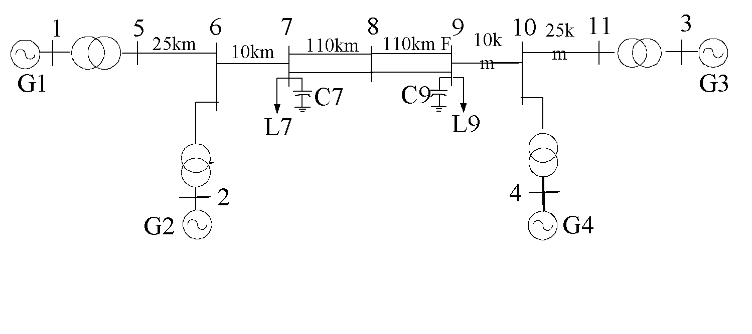
Network Details
Sbase=100MVA
Slack Bus: 1
PV Bus: 3
PQ Bus: 7
Total: 11 Buses
T1
T3
4 Transformers:
T2
T4
Transformers | Rated Power(MVA) | Voltage ratio: K=1 | ZT
T1 | 900 | 1 | j0.15
T2 | 900 | 1 | j0.15
T3 | 900 | 1 | j0.15
T4 | 900 | 1 | j0.15

Slide 3
Line Info (Given)
Line | Distance（km） | r_{o}(p.u/km) | x_{o}(p.u/km) | b_{o}(p.u/km)
L₅₆ | 25 | 0.0001 | 0.001 | 0.00175
L₆₇ | 10 | 0.0001 | 0.001 | 0.00175
L₇₈ | 110 | 0.0001 | 0.001 | 0.00175
L₈₉ | 110 | 0.0001 | 0.001 | 0.00175
L₉₋₁₀ | 10 | 0.0001 | 0.001 | 0.00175
L₁₀₋₁₁ | 25 | 0.0001 | 0.001 | 0.00175
Capacitors’ Susceptance:
C7=j2.1 ; C9=j3.6

Slide 4
Bus Info (Given)
Bus | Type | P | Q | |V| | θ(degree)
1 | PV | 7.00 |  | 1.03
2 | PV | 7.00 |  | 1.01
3 | Slack |  |  | 1.03 | 0.0
4 | PV | 7.00 |  | 1.01
5 | PQ | 0.00 | 0.00
6 | PQ | 0.00 | 0.00
7 | PQ | 9.67 | 1.00
8 | PQ | 0.00 | 0.00
9 | PQ | 17.67 | 1.00
10 | PQ | 0.00 | 0.00
11 | PQ | 0.00 | 0.00

Slide 5
Initial Guess & Y Admittance Matrix
All PV bus with voltage angle = 0
All PQ bus with |voltage| = 1, Angle = 0°
3.9604-j99.582 | -3.9604+j39.604 |  |  |  |  |  | 0+j60
-3.9604+j39.604 | 13.861-j198.58 | -9.901+j99.01 |  |  |  |  |  | 0+j60
 | -9.901+j99.01 | 11.701-j114.71 | -1.8002+j18.002
 |  | -1.8002+j18.002 | 3.6004-j35.619 | -1.8002+j18.002
 |  |  | -1.8002+j18.002 | 11.701-j113.21 | -9.901+j99.01
 |  |  |  | -9.901+j99.01 | 13.861-j198.58 | -3.9604+j39.604 |  |  | 0+j60
 |  |  |  |  | -3.9604+j39.604 | 3.9604-j99.582 |  |  |  | 0+j60
0+j60 |  |  |  |  |  |  | 0-j60
 | 0+j60 |  |  |  |  |  |  | 0-j60
 |  |  |  |  | 0+j60 |  |  |  | 0-j60
 |  |  |  |  |  | 0+j60 |  |  |  | 0-j60
Y=

Slide 6
Gauss-Seidal Result
Bus | |Voltage| | Angle (Degree) | Complex
1 | 1.0300 | -1.5690 | 1.0300 - j0.0019
2 | 1.0100 | -1.5689 | 1.0100 - j0.0019
3 | 1.0300 | 0 | 1.0300 + j0.0000
4 | 1.0100 | -1.5689 | 1.0100 - j0.0019
5 | 1.0004 | -1.6244 | 0.9989 - j0.0536
6 | 0.9487 | -1.7116 | 0.9393 - j0.1331
7 | 0.8885 | -1.8477 | 0.8547 - j0.2429
8 | 0.5714 | -2.0561 | 0.5054 - j0.2665
9 | 0.2275 | 3.0700 | 0.2270 + j0.0163
10 | 0.3340 | -1.6011 | 0.3338 - j0.0101
11 | 0.6433 | -0.2481 | 0.6236 - j0.1580

Slide 7
Newton-Raphson Result
Bus | |Voltage| | Angle (Degree) | P + jQ
1 | 1.03 | 26.922 | 7 + j1.810
2 | 1.01 | 17.168 | 7 + j2.250
3 | 1.03 | 0 | 7.187 + j1.716
4 | 1.01 | -10.171 | 7 + j1.918
5 | 1.0071 | 20.464 | 0
6 | 0.9797 | 10.397 | 0
7 | 0.9638 | 2.019 | -9.670 - j1
8 | 0.9518 | -11.770 | 0
9 | 0.9744 | -25.285 | -17.670 - j1
10 | 0.9851 | -16.904 | 0
11 | 1.0090 | -6.619 | 0

Slide 8
Current Result
Bus I | Bus J | Current (From I to J) | Current (From J to I)
1 | 5 | 6.855294 + j1.510179 | -6.855294 - j1.510179
5 | 6 | 6.855294 + j1.510179 | -6.866864 - j1.468460
2 | 6 | 7.279377 - j0.082425 | -7.279377 + j0.082425
6 | 7 | 14.146241 + j1.386035 | -14.148085 - j1.369174
7 | 8 | 2.078187 + j0.014903 | -2.062768 + j0.167495
8 | 9 | 2.062768 - j0.167495 | -2.004024 + j0.341979
9 | 10 | -13.449209 + j4.818059 | 13.455357 - j4.80210
4 | 10 | 6.486440 - j3.093086 | -6.486440 + j3.093086
10 | 11 | -6.968917 + j1.709016 | 6.977727 - j1.666474
3 | 11 | 6.977727 - j1.666474 | -6.977727 + j1.666474
7 | 0 | -0.071299 + j2.022827 | 0
9 | 0 | 1.498220 + j3.171676 | 0

Slide 9
Power Flow Result
Bus I | Bus J | S (From I to J) | S (From J to I) | Line Loss S
1 | 5 | 7.000000 + j1.810135 | -7.000000 - j0.988874 | 0.000000 + j0.821262
5 | 6 | 7.000000 + j0.988874 | -6.876701 + j0.200930 | 0.123299 + j1.189803
2 | 6 | 7.000000 + j2.249742 | -7.000000 - j1.366474 | 0.000000 + j0.883269
6 | 7 | 13.876701 + j1.165544 | -13.674644 + j0.838505 | 0.202058 + j2.004050
7 | 8 | 2.002322 + j0.056203 | -1.954598 + j0.244420 | 0.047724 + j0.300623
8 | 9 | 1.954598 - j0.244420 | -1.907910 + j0.532728 | 0.046688 + j0.288309
9 | 10 | -13.854180 + j1.352375 | 14.058299 + j0.672013 | 0.204119 + j2.024387
4 | 10 | 7.000000 + j1.918092 | -7.000000 - j1.057407 | 0.000000 + j0.860685
10 | 11 | -7.058299 + j0.385394 | 7.187059 + j0.858704 | 0.128760 + j1.244098
3 | 11 | 7.187059 + j1.716468 | -7.187059 - j0.858704 | 0.000000 + j0.857763
7 | 0 | 0.000000 - j1.950911 | 0 | 0.000000 - j1.950911
9 | 0 | 0.000000 - j3.417832 | 0 | 0.000000 - j3.417832

Slide 10

One-Line Fault Analysis
Sbase=100MVA
We choose to delete the Bus 5, and the new electrical network is:
Slack Bus: 1
PV Bus: 3
PQ Bus: 6
Total: 10 Buses
4 Transformers:
Transformers | Rated Power(MVA) | Voltage ratio: K=1 | ZT
T1 | 900 | 1 | j0.15
T2 | 900 | 1 | j0.15
T3 | 900 | 1 | j0.15
T4 | 900 | 1 | j0.15
Other initial conditions remain the same: line & bus info

Slide 11
One-Line Fault Result: Newton-Raphson
Bus | |Voltage| | Angle (Degree) | P + jQ
1 | 1.03 | 37.135541 | 7 + j2.419799
2 | 1.01 | 37.265257 | 7 + j1.176506
3 | 1.03 | 0 | 7.073890 + j1.498509
4 | 1.01 | -9.845945 | 7 + j1.457941
6 | 0.997298 | 30.614072 | 0
7 | 0.973899 | 22.440945 | -9.67 - j1
8 | 0.932464 | -6.768899 | 0
9 | 0.987512 | -20.604789 | -17.67 - j1
10 | 0.992685 | -16.528177 | 0
11 | 1.012245 | -6.492871 | 0

Slide 12
One-Line Fault Result: Current
Bus I | Bus J | Current (From I to J) | Current (From J to I)
1 | 6 | 6.836220 + j2.229933 | -6.836220 - j2.229933
2 | 6 | 6.221057 + j3.269534 | -6.221057 - j3.269534
6 | 7 | 13.057276 + j5.499468 | -13.064973 - j5.484081
7 | 8 | 4.276466 + j0.752545 | -4.301671 - j0.576781
8 | 9 | 2.150835 + j0.288391 | -2.106808 - j0.110299
9 | 10 | -6.714961 + j2.068952 | 6.720473 - j2.052537
4 | 10 | 6.581772 - j2.607391 | -6.581772 + j2.607391
10 | 11 | -6.859173 + j1.497682 | 6.867854 - j1.454864
3 | 11 | 6.867854 - j1.454864 | -6.867854 + j1.454864
7 | 0 | -0.780712 + j1.890314 | 0
9 | 0 | 1.251090 + j3.327626 | 0

Slide 13
One-Line Fault Result: Power Flow
Bus I | Bus J | S (From I to J) | S (From J to I) | Line Loss S
1 | 6 | 7.000000 + j2.419799 | -7.000000 - j1.558024 | 0.000000 + j0.861775
2 | 6 | 7.000000 + j1.176506 | -7.000000 - j0.353316 | 0.000000 + j0.823190
6 | 7 | 14.000000 + j1.911340 | -13.799230 + j0.079359 | 0.200770 + j1.990699
7 | 8 | 4.129230 + j0.912449 | -3.919802 + j1.006853 | 0.209428 + j1.919302
8 | 9 | 1.959901 - j0.503427 | -1.909076 + j0.834122 | 0.050824 + j0.330695
9 | 10 | -6.925924 + j0.421201 | 6.975302 + j0.055431 | 0.049379 + j0.476632
4 | 10 | 7.000000 + j1.457941 | -7.000000 - j0.622638 | 0.000000 + j0.835304
10 | 11 | -6.950605 + j0.511775 | 7.073890 + j0.677109 | 0.123285 + j1.188884
3 | 11 | 7.073890 + j1.498509 | -7.073890 - j0.677109 | 0.000000 + j0.821401
7 | 0 | 0.000000 - j1.991808 | 0 | 0.000000 - j1.991808
9 | 0 | 0.000000 - j3.510645 | 0 | 0.000000 - j3.510645

Slide 14
Comparison
Compared to the original grid, there are some changes in the new grid.
For each PQ bus (6-11), the absolute value of voltage slightly increases while the phase value changes a lot.
For the slack bus and all the PV buses (1-4), the phase value of voltage and input power changes a little bit.
For the power flow changes in each line, if the line is closer to the deleted bus, the changes in the power flow, line losses and line current will be greater.
In summary, the failure of bus 5 does not cause significant changes in the new system.

